Slide 1
Strategic Plan Update
Board of Education
Theme: Support and develop UCPS Employees
Strategic Initiative: (1b) Develop an employee recognition system to increase retention of high-quality team members
Executive Sponsor – Dr. Chris Barnes
Initiative Owner – Laura French

Slide 2
Strategic Theme
Support and develop UCPS employees

Slide 3
Strategic Initiative
Develop an employee recognition system to increase retention of high-quality team members.

Slide 4
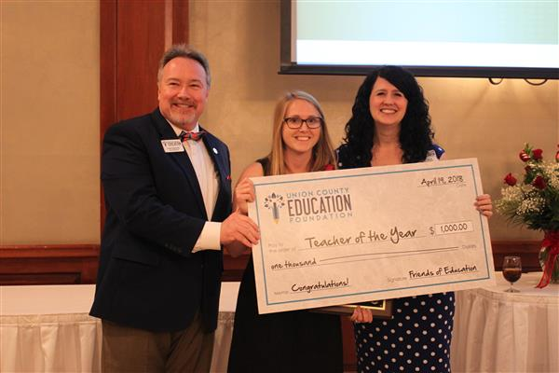
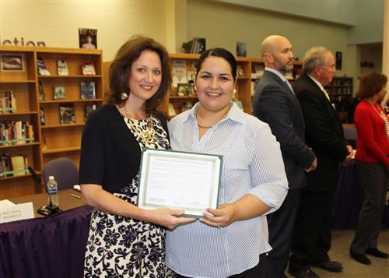
Previous STATE
Individual School and Department Initiatives
Employee of the Month
Regional/State Affiliated Programs
Teacher of the Year
Principal of the Year
Retiree Banquet
Board of Education and Website Recognition

Slide 5
Desired STATE
A District Wide Recognition Program for All UCPS Employees
Longevity Awards
Employee Appreciation Cards
Customer Service Award Program
Employee Spotlight Newsletter
Semi-Annual District Recognition Events
Corporate Sponsorships

Slide 6
PERFORMANCE INDICATORS from sec. VIII
Year 1
Performance Indicator | Measurement Method | Targeted Achievement
Reduce the Attrition Rate of UCPS Employees | Monthly Attrition Data, Exit Survey Feedback | UCPS will retain valuable employees and reduce costs associated with onboarding and training new employees.
Solicit and Engage Corporate Partnerships to Sponsor Recognition Programs | Corporate Sponsorship Agreements | District wide recognition awards and events promote corporate sponsors and sustain district recognition initiatives.
Plan, Develop and Implement Customer Service Program | Program rubric and selection process finalized. | Schools are recognized annually for their excellence at providing customer service to stakeholders.
Plan, Develop and Implement Lanyard Pin and U Matter Card Programs | Recognition rubrics and award processes finalized. | Staff are rewarded on a regular basis for achievement in defined categories.
Create a Marketing Plan to Promote Recognition Programs | Marketing Plan Aligned with UCPS Communication Guidelines | Communication of recognition initiatives to all employee groups through a variety of print and digital platforms.

Slide 7
TIMELINE from VII
 | Advancing degree program with university partnerships (Wingate/UNCC, etc.) -TA to T Program -T to Admn Program -UCPS Teaching Fellows Program | -UCPS Representatives -University contacts -Identified UCPS Staff | 11/2017 | On-going
 | Introduce new interview protocol- “Hire Forward” to screen applicants for principals | -UCPS HR Staff -Principals | 10/2017 | On-going
 | Focus on development and support of BT 1s, 2s, and 3s | -UCPS HR Staff -UCPS Teaching and Learning | 11/2017 | On-going
 | Create new employee marketing plan to utilize a variety of digital tools to enhance communication with prospective applicants | -UCPS HR Staff -UCPS Communications Dept. - | 1/2018 | On-going
Action Item # | Milestone Deliverable or Activity |  | Proposed Start Date | Proposed Due Date
 | Development of 5 year recruitment and hiring plan to maintain a workforce of effective and qualified professionals | -HR Staff | 11/2017 | January, 2018
 | Review current onboarding procedures and develop: a) survival guide, b) FAQ, and c) enhanced Frontline Central services. Request input from recently hired UCPS staff. | -UCPS Human Resources/Finance department for benefits and hiring -Other | 10/2017 | January, 2018 (Survival Guide)
 | Enhance Mentor Training Program | -HR Representatives -Lead UCPS Mentors (stipend) -Possible mentor | 11/2017 | On-going
 | Plan, Implement and Articulate Career Fairs for attaining the most highly qualified candidates -Hire Forward -Targeted Recruitment -Compensation Specialist | -HR Representatives -Administrative reps -Auxiliary Services reps | 11/2017 | On-going (Fall/Spring)

Slide 8
QUESTIONS?

Slide 9
TIMELINE
Completed
In progress
Not yet started
Milestone Deliverable or Activity | Progress
Create a Marketing Plan to Promote Recognition Programs
Solicit and Engage Corporate Partnerships to Sponsor Recognition Programs
Plan, Develop and Implement Customer Service Program
Plan, Develop and Implement Longevity Recognition and Appreciation Card Programs
Reduce the Attrition Rate for UCPS Employees

Slide 10
TIMELINE
Completed
In progress
Not yet started
Milestone Deliverable or Activity | Progress
Enhance Mentor Training Program
Begin Hire Forward Initiative
Focus development and support of Beginning Teachers (1s, 2s, 3s)
Create marketing plan to enhance communication with prospective applicants

Slide 11
CURRENT/DESIRED STATE from sec III
Currently, a variety of activities are utilized to support the recruitment efforts. To attain prospective employees, recruitment efforts include participation in University Careers fairs, locally sponsored Career Fairs and outreach to local universities to increase awareness of student teachers. To retain employees, we have a mentor program that supports teachers new to the profession and new to Union County. In addition, professional development is offered to support teacher development. Targeted bonuses exist as well as some forms of employee recognition (UCPS TOY and UCPS Employee of the Month).

